Slide 1



CREATE EMPLOYEE PROFILE!

Slide 2
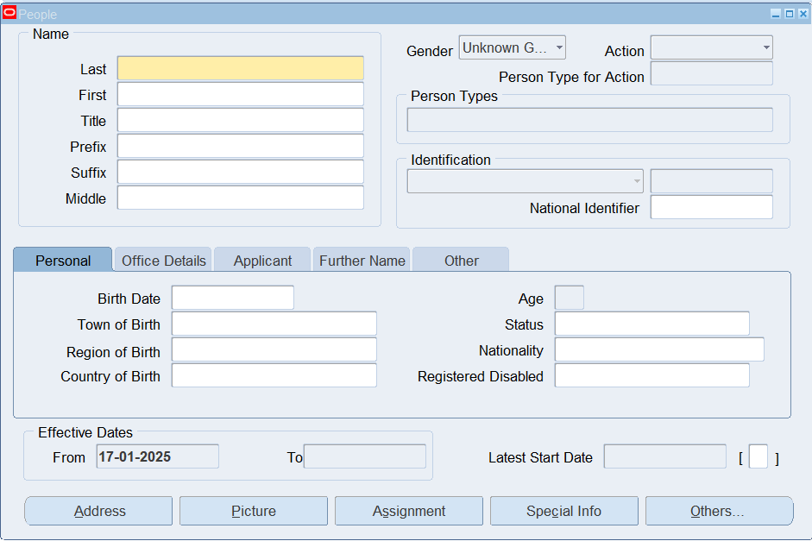

HRMS > People > Enter and Maintain > New
Fill out personal information

Slide 3
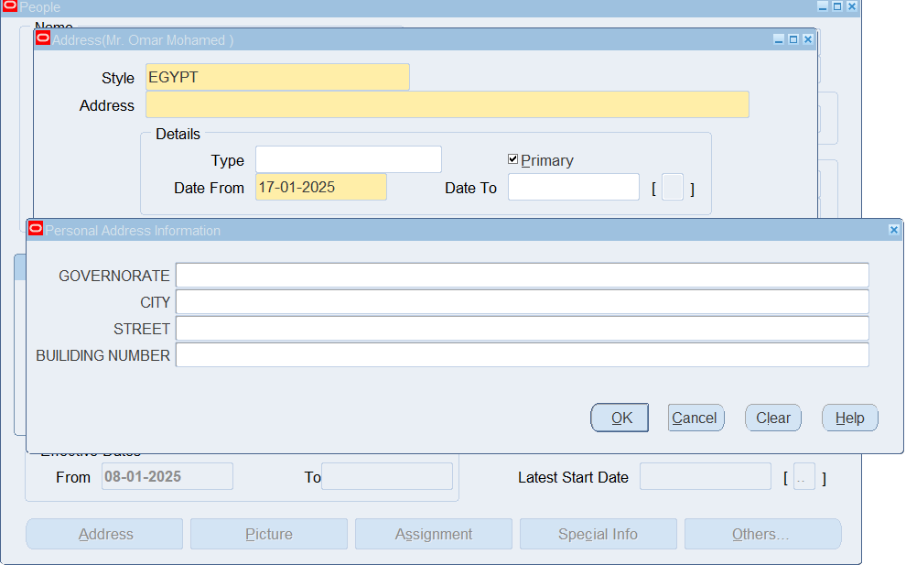
Address Button

Slide 4
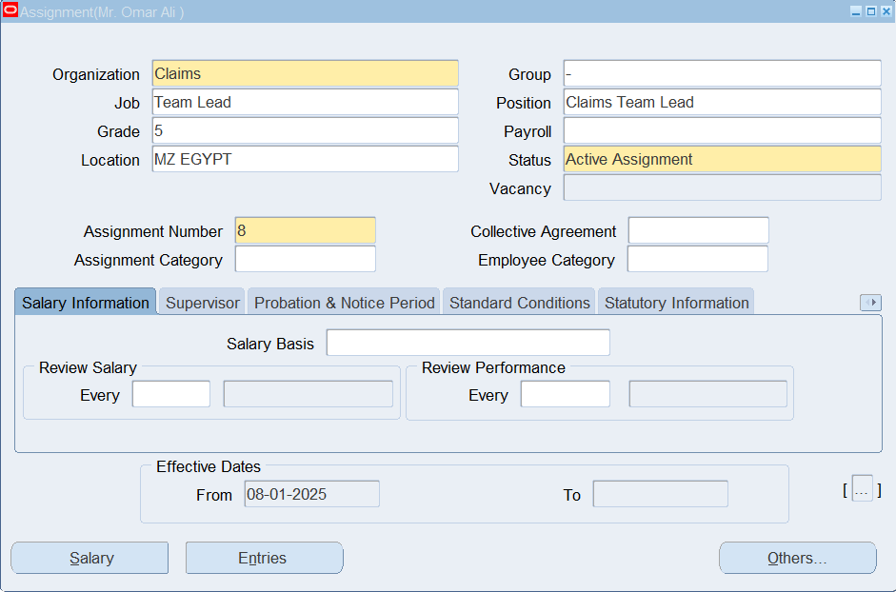
Assignment Button

Slide 5
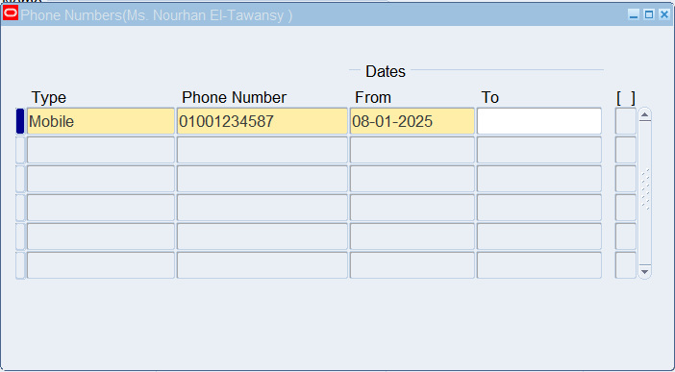
Others Button > Phones

Slide 6
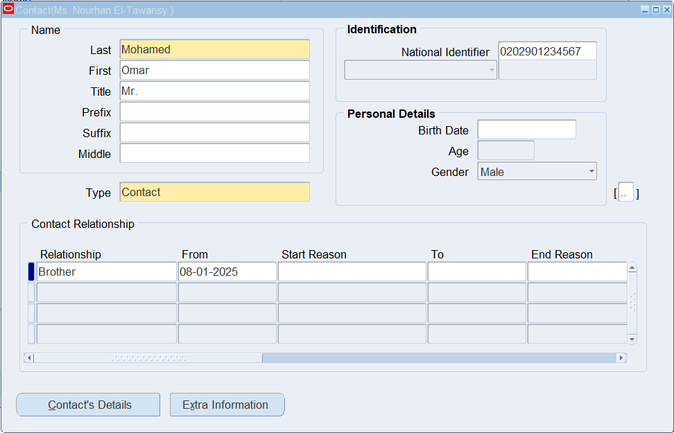
Others Button > Contact

Slide 7
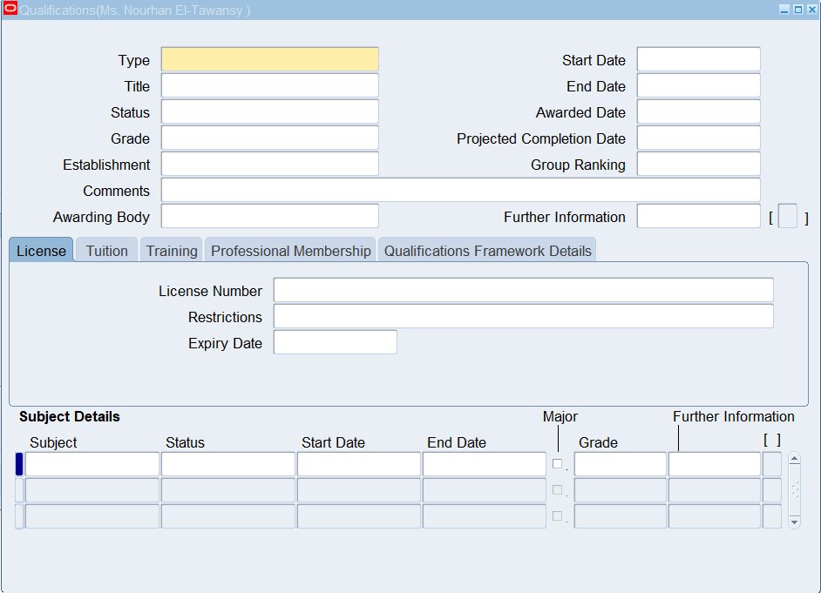
Others Button > Qualifications

Slide 8
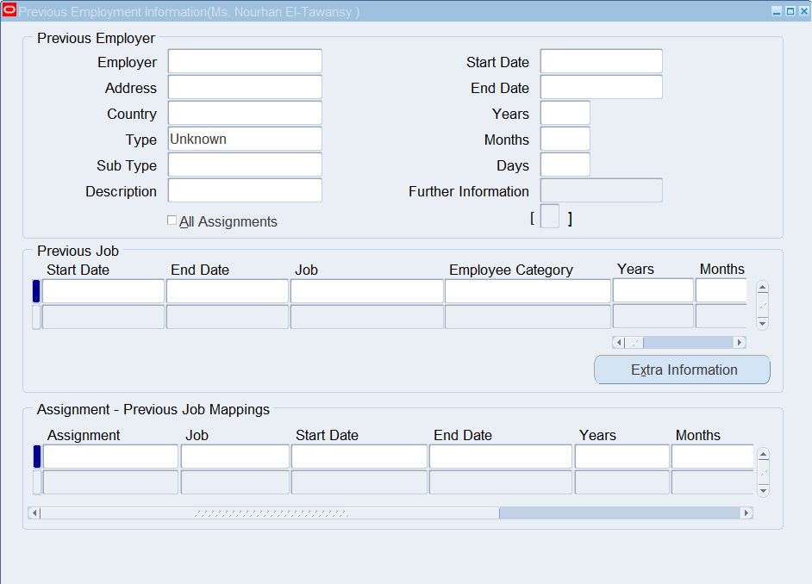
Others Button > Previous Employment

Slide 9
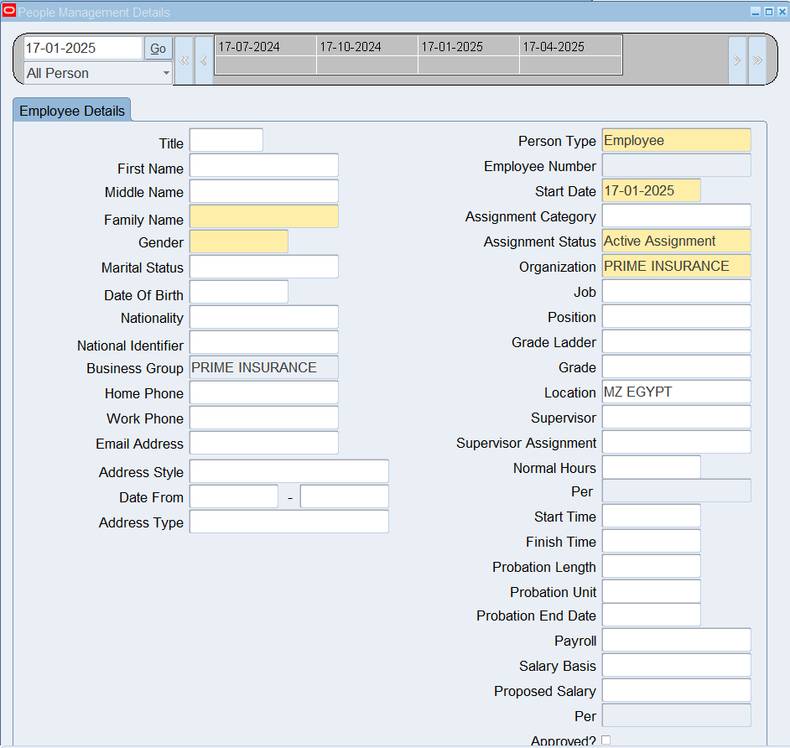
Create an Employee Using Templates
HRMS > People > Maintain Using Templates > Entering Employees
To edit profiles:
HRMS > People > Maintain Using Templates > Maintaining Employees

Slide 10
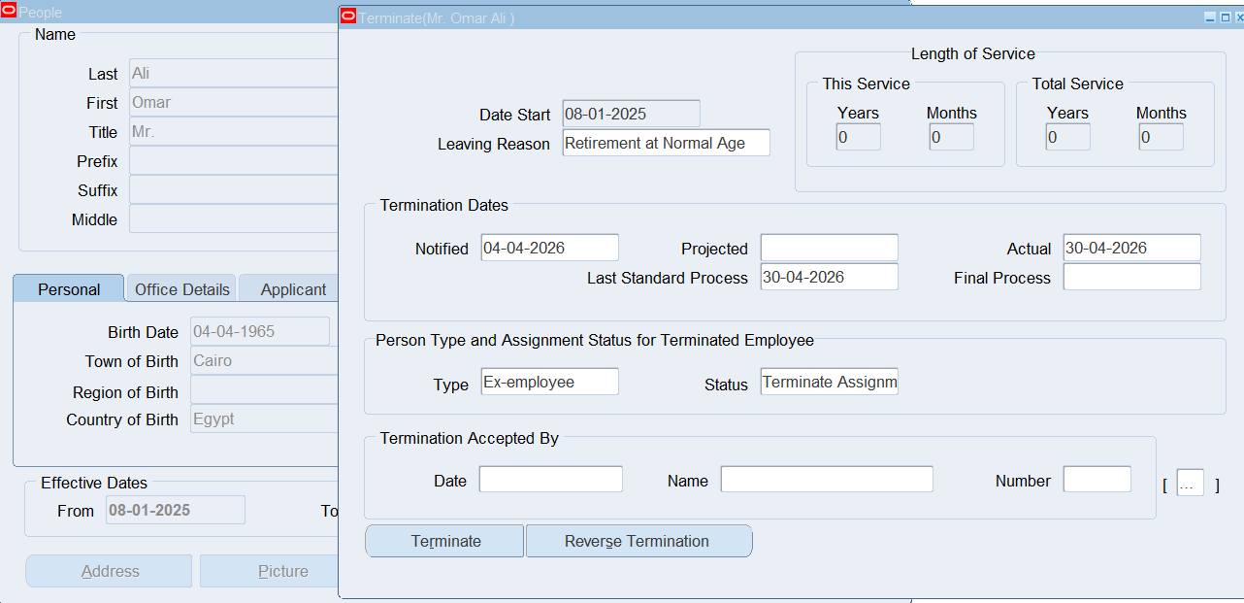
People Window > Others Button > End Employment

Slide 11
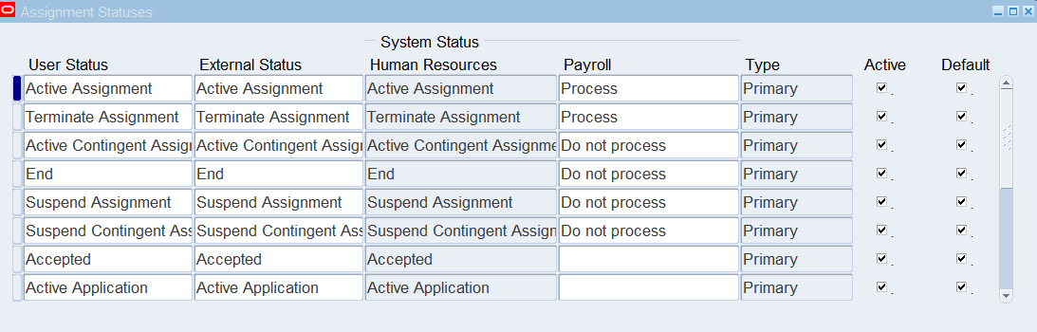
Assignment Status
This can also be customized based on the statuses the company is categorizing its employees by
HRMS > Work Structures > Status
Press on +New icon to add a new assignment status

Slide 12
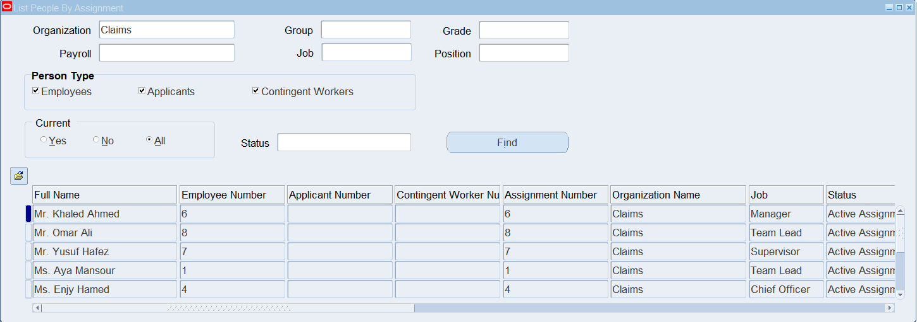
View Lists
HRMS > View > Lists > People by Assignment

Slide 13

PAYROLL MANAGEMENT

Slide 14
1
2
3
4
Define Consolidation Set
Egypt Legislation
Bank Details Flexfield
Define Monetary Unit
5
6
7
Define Payment Type
Define Payment Method
Define Payroll

Slide 15
1
Egypt Legislation

Slide 16
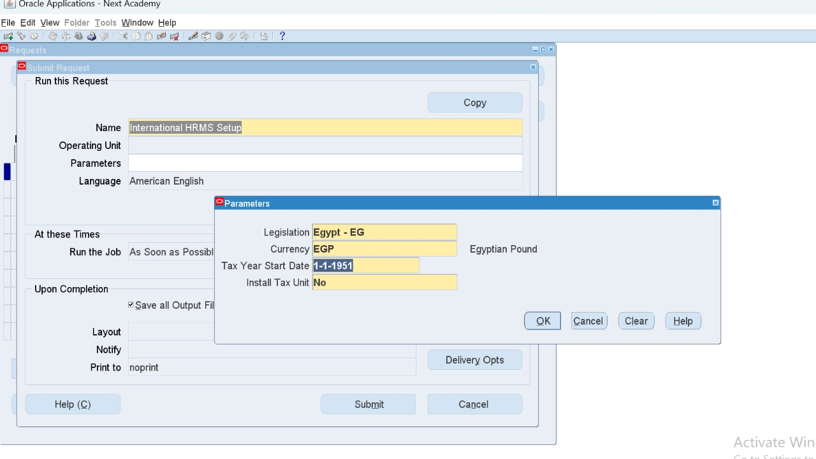
HRMS > View > Requests
Request Name: International HRMS Setup

Slide 17
2
Bank Details Flexfield

Slide 18
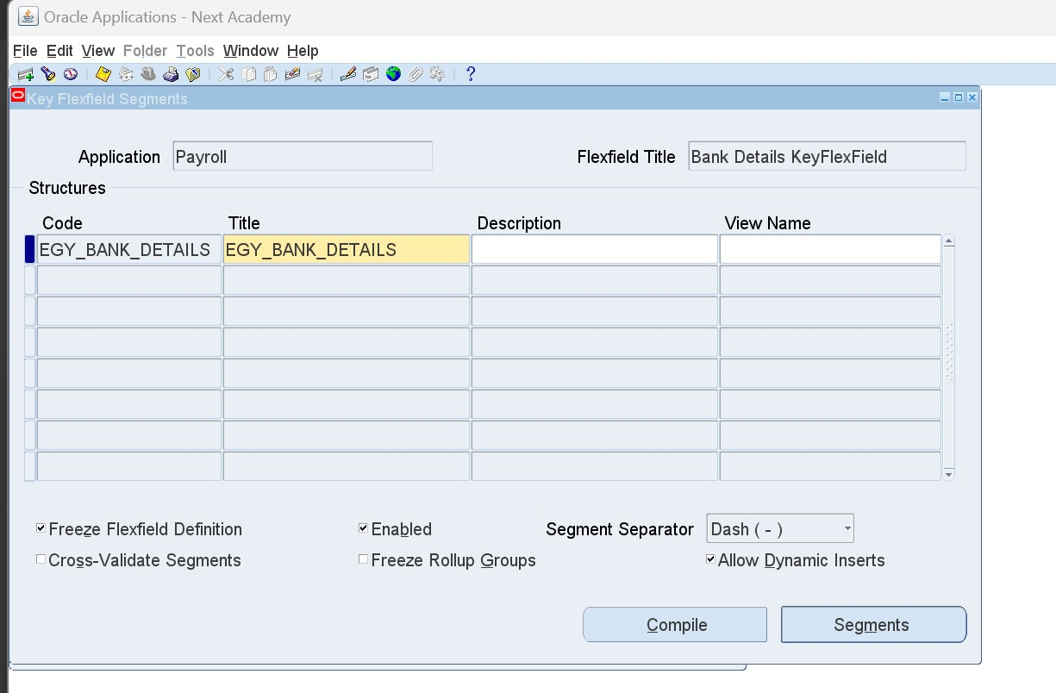
Bank Details flexfield is standard
Sysadmin > Application > Flexfield > Key > Segments
Application: Payroll - Bank Details KeyFlexField (EG_Bank_Details)

Slide 19
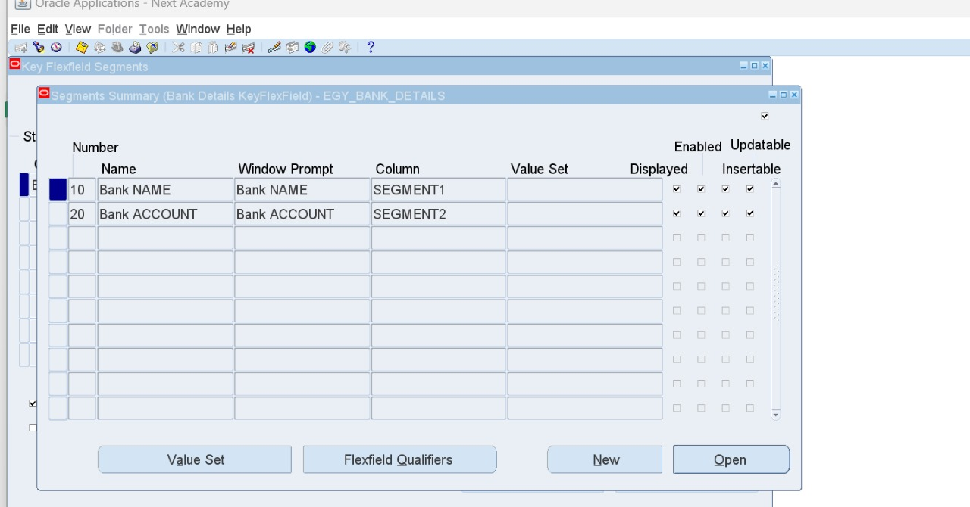
Add the needed segments

Slide 20
3
Define Monetary Unit

Slide 21
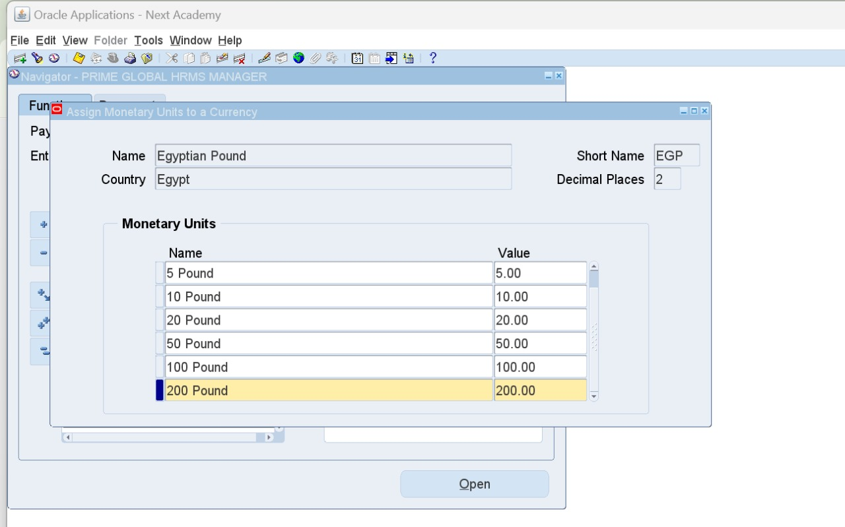
HRMS > Payroll > Monetary Units
Find Currency: EGP then add units 5,10,20,50,100,and 200

Slide 22
4
Define Consolidation Set

Slide 23
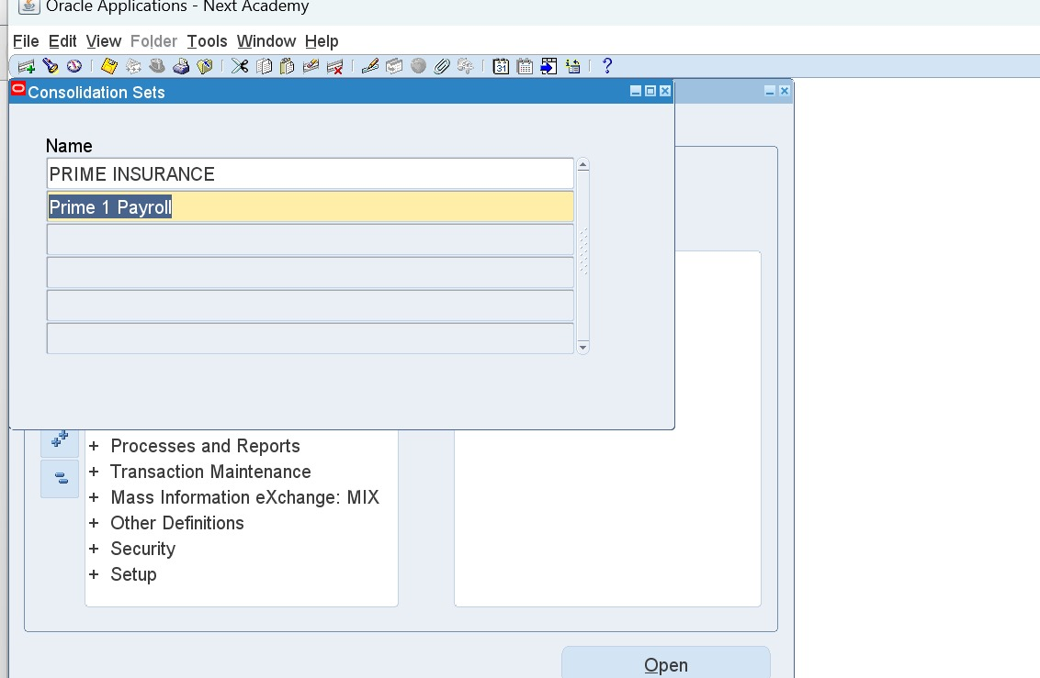
HRMS > Payroll > Consolidation
Name could be the same as Payroll Name or Assignment Set Name
Remember to alter date to BG creation date 01-01-1951

Slide 24
5
Define Payment Type

Slide 25
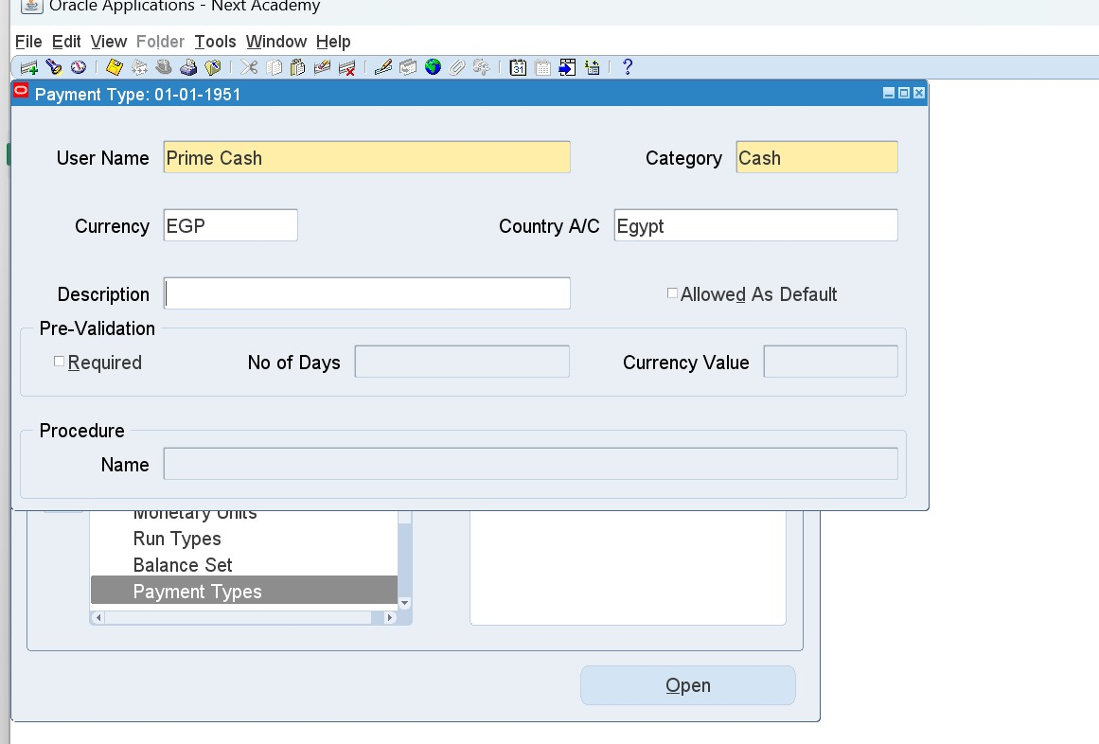
Payment Type is on Organizational Level
HRMS > Payroll > Payment Types
(CASH – CHECK – BANK)
To define Cash and Check, create them manually and choose the same category.

Slide 26
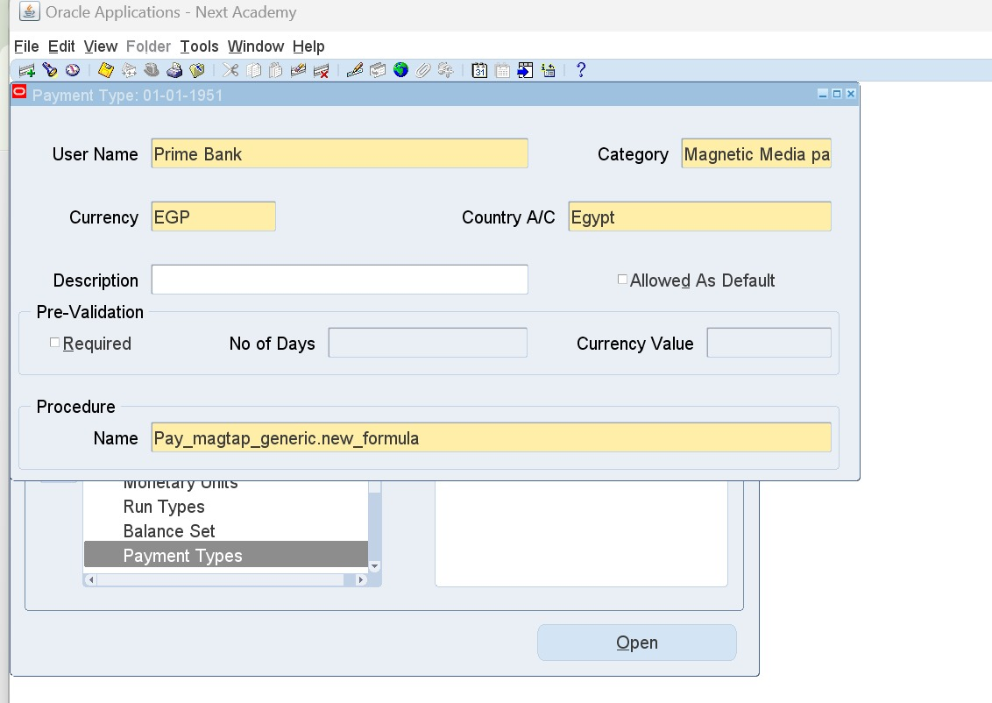
To define Bank Payment Type
F11 and search for %Bank%
Copy category and procedure name entries
Category: Magnetic Media payment
Procedure Name: Pay_magtap_generic.new_formula
Create a new bank definition with same details

Slide 27
6
Define Payment Method

Slide 28
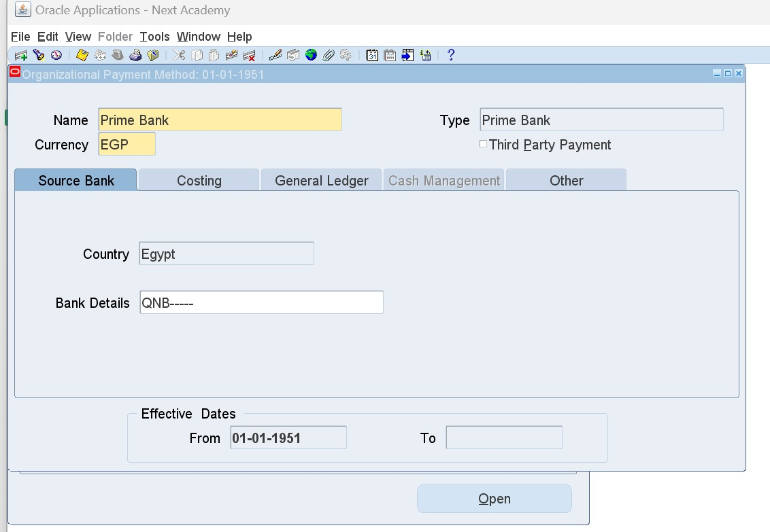
Payment Method is on Employee Level
HRMS > Payroll > Payment Methods
Add new method CASH
Type: Choose predefined payment types (Prime Cash – Prome Check – Prime Bank)
For Bank, make sure to fill out the bank details flexfields.

Slide 29
7
Define Payroll

Slide 30
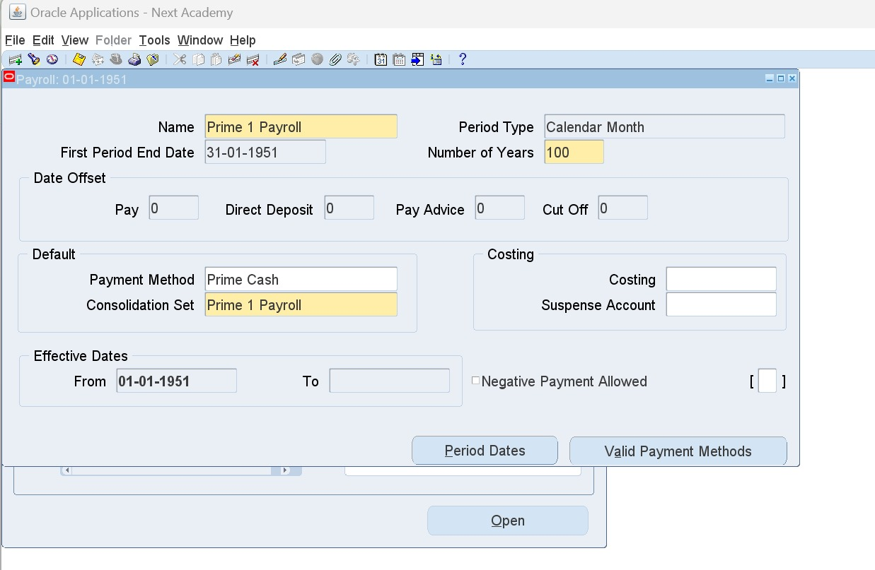
HRMS > Payroll > Description
Use same pre-defined Consolidation Set name
Period Type: Calendar Month
Number of Years: 100 years
Payment Method should always be CASH

Slide 31
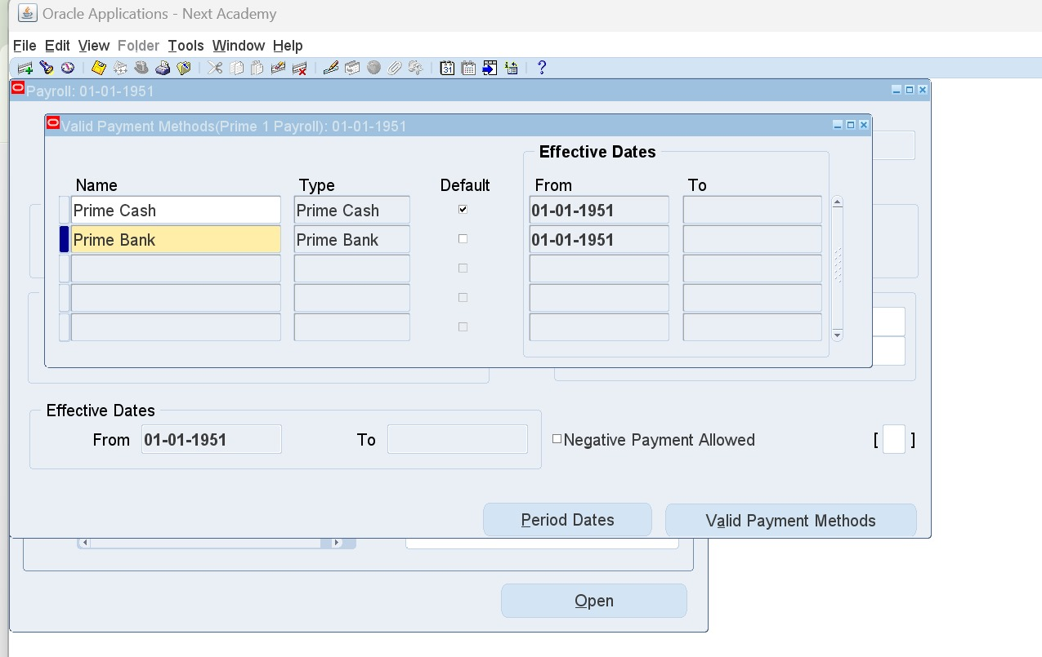
Valid Payment Method button:
Define pre-defined payment methods (Cash - Check - Bank)
Period Dates button: Shows all payroll cycles; end a payroll by changing the status to Closed

Slide 32
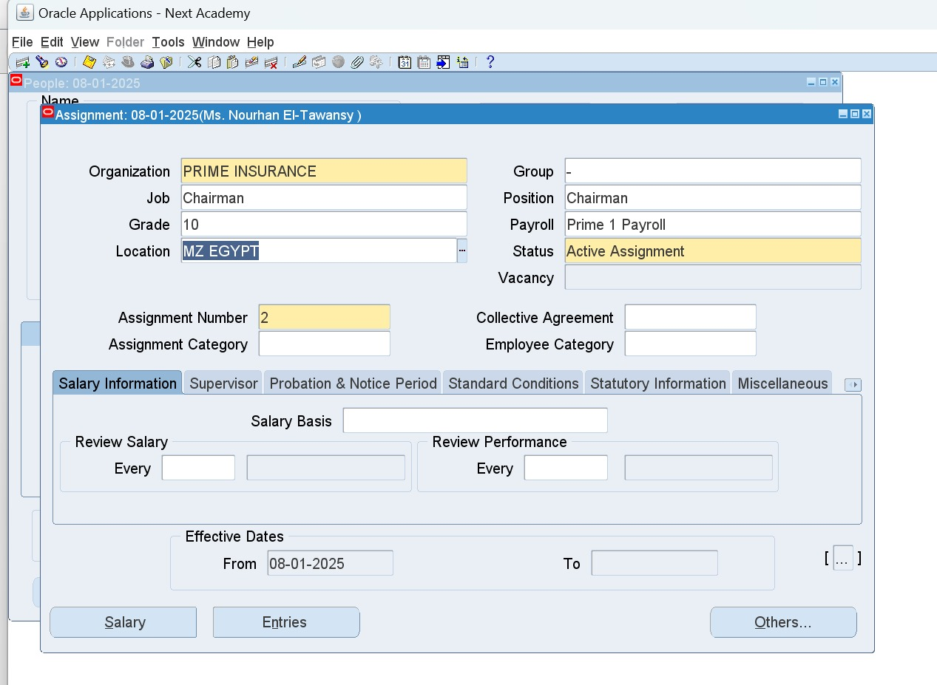
Assign Defined Payroll to Employees
HRMS > People > Enter and Maintain > People Window > Assignment button
Payroll Field

Slide 33

Elements

Slide 34
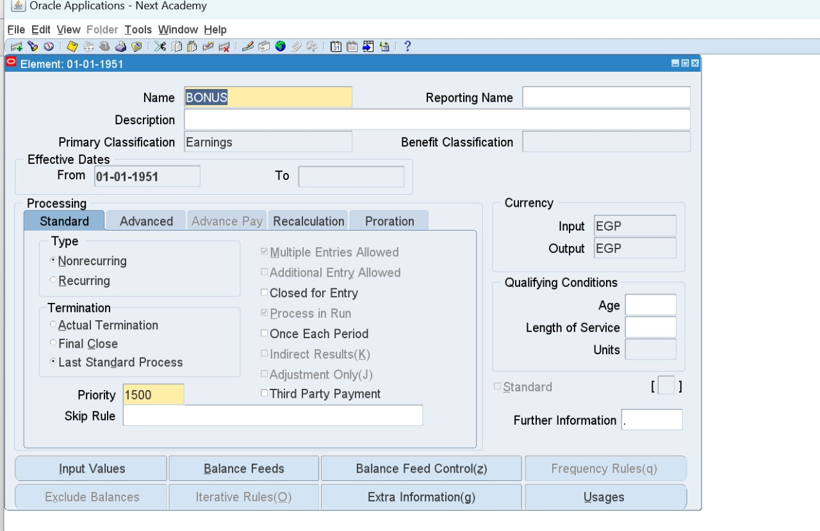
Elements Entries
HRMS > Total Compensation > Basic > Element Description
Earning: Any added amount to the income.
Voluntary Deduction: Any requested deduction, Ex. Loan installments.
Involuntary Deduction: Any obligatory deductions, Ex. Tax.
Information: Any added allowances that is not translated into money, Ex. Housing.

Slide 35
Save > Input Values Button
Uncheck User Enterable
Validation Hot Default

Slide 36
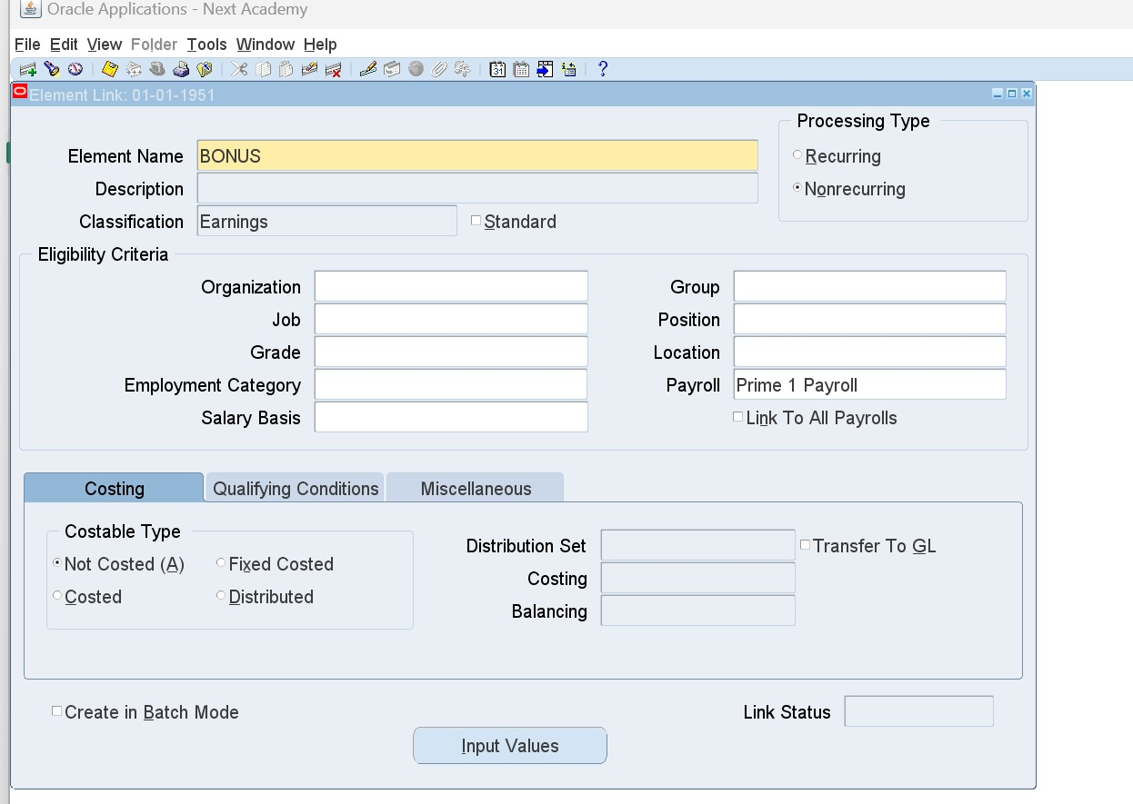
Elements Link
HRMS > Total Compensation > Basic > Link
Choose element and its eligibility criteria (leave them empty to apply to all)
To delete a link, press on the effective date in miscellaneous tab, press on delete icon, End Date.
To reactivate a link, press on end date in miscellaneous tab, press on delete icon, Next.

Slide 37
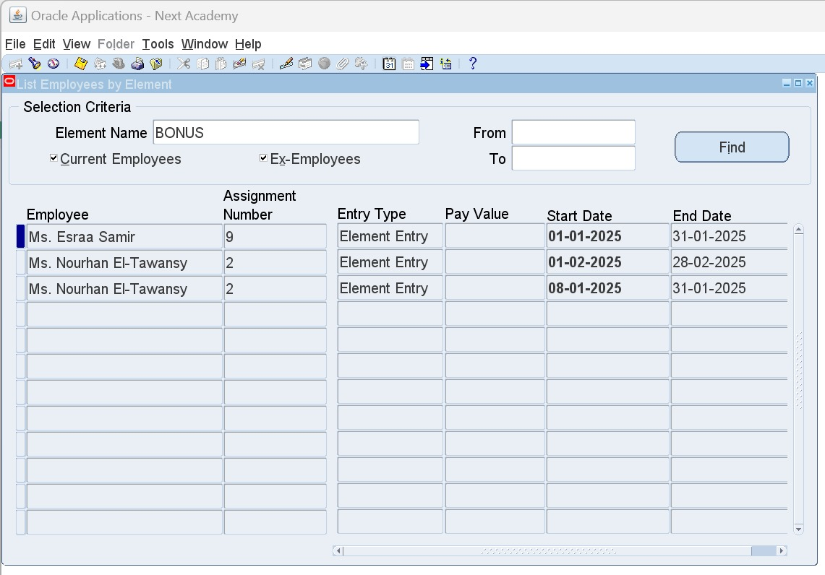
To delete an element, it should never be attached to any employee
HOW TO DELETE AN ELEMENT?
Firstly list employees who are linked to it
HRMS > View > Lists > Employees by Element
Search by element name to list all employees linked to it

Slide 38
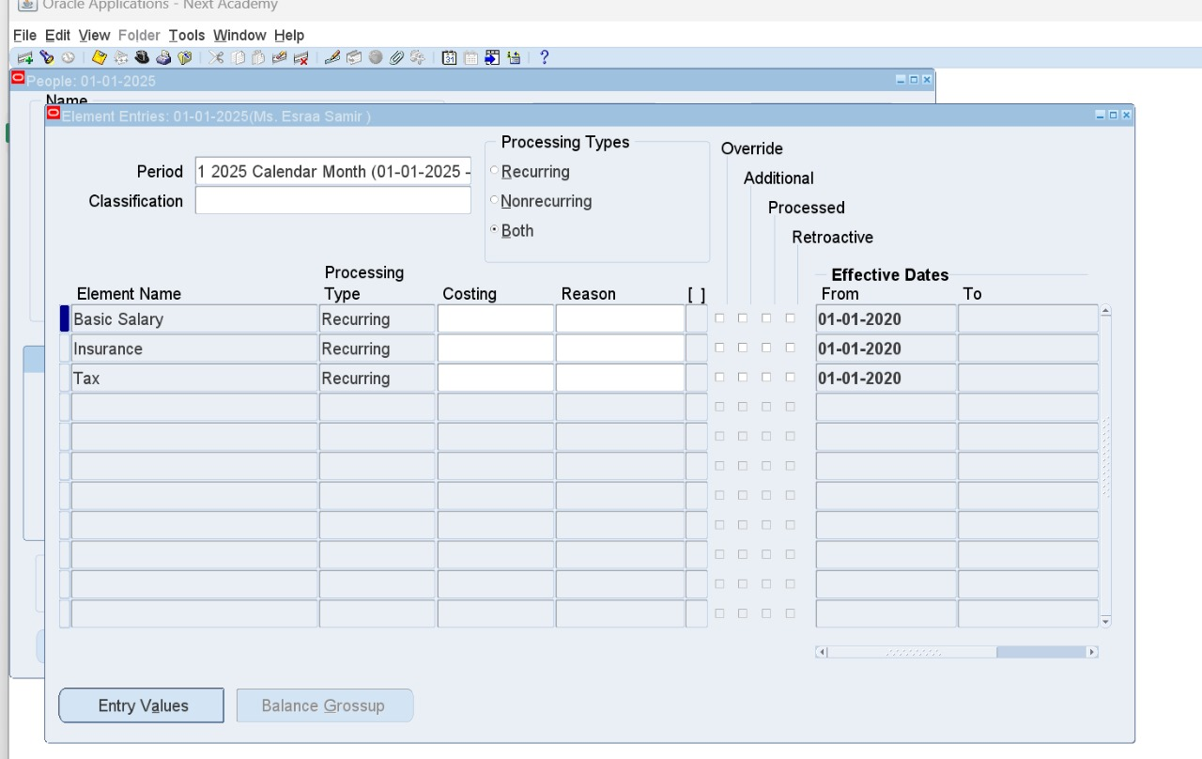
1. Delete Entries
HRMS > People > Enter and Maintain > Assignment Window > Enteries Button
Select Entry - Delete icon - Choose "Purge"

Slide 39
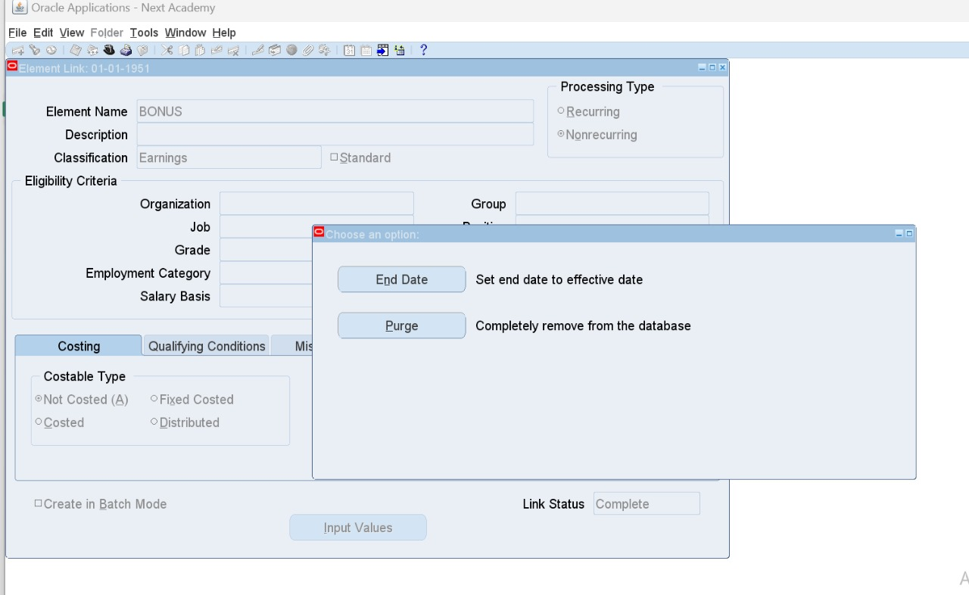
2. Delete Link
HRMS > Total Compensation > Basic > Link
Select Link - Delete icon - Choose "Purge"

Slide 40
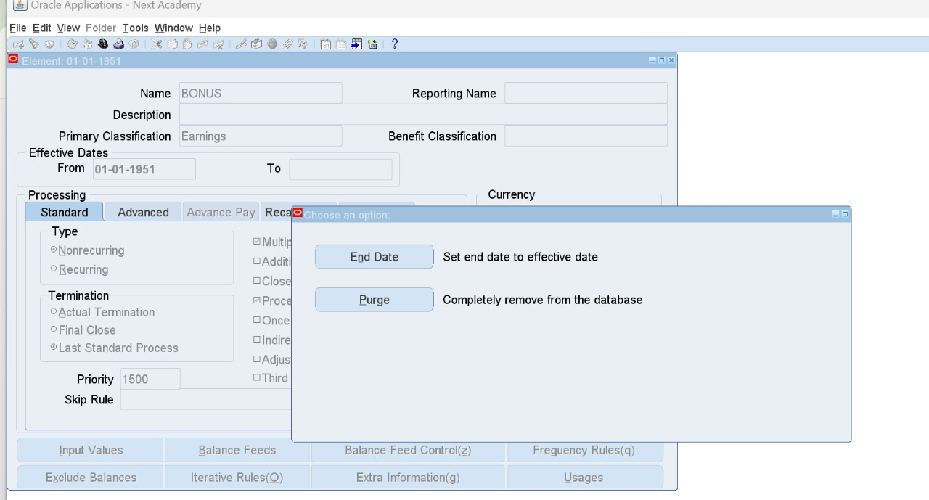
3. Delete Element
HRMS > Total Compensation > Basic > Element Description
Select Element - Delete icon - Choose "Purge“
(In case payroll got run choose End Date"

Slide 41

Salary Administration Setup

Slide 42
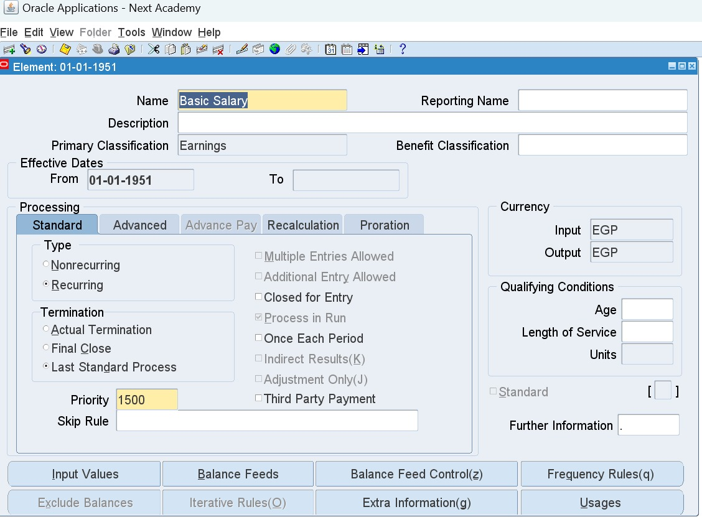
1. Create an element “Basic Salary”
HRMS > Total Compensation > Basic > Element Description
Uncheck User Enterable from Input Values window

Slide 43
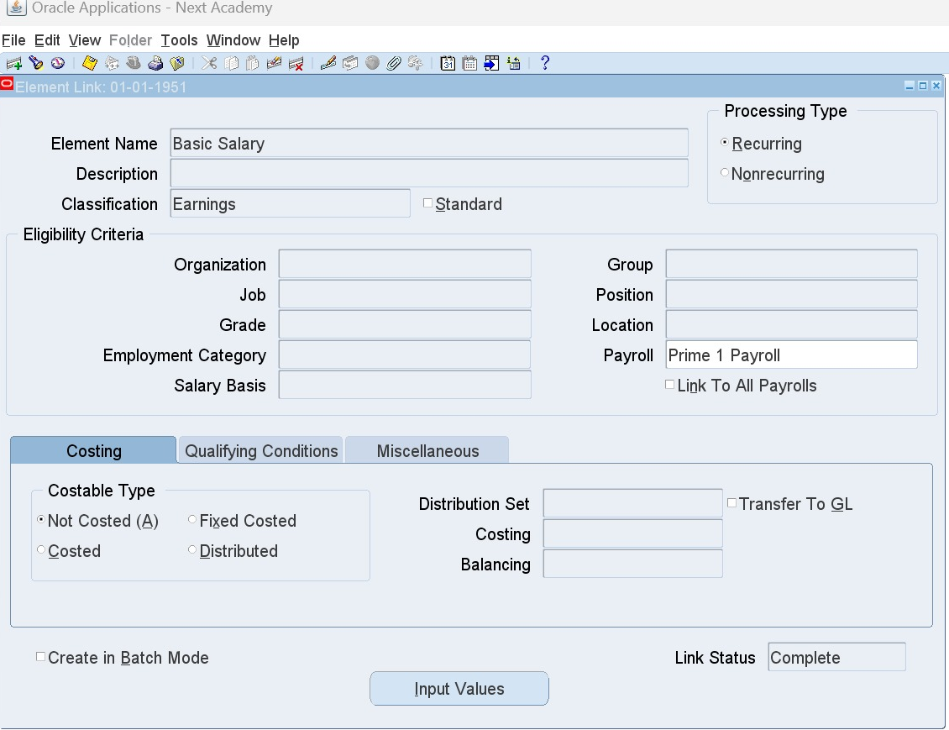
2. Add Element Link
HRMS > Total Compensation > Basic > Link
Choose defined element "Basic Salary"

Slide 44
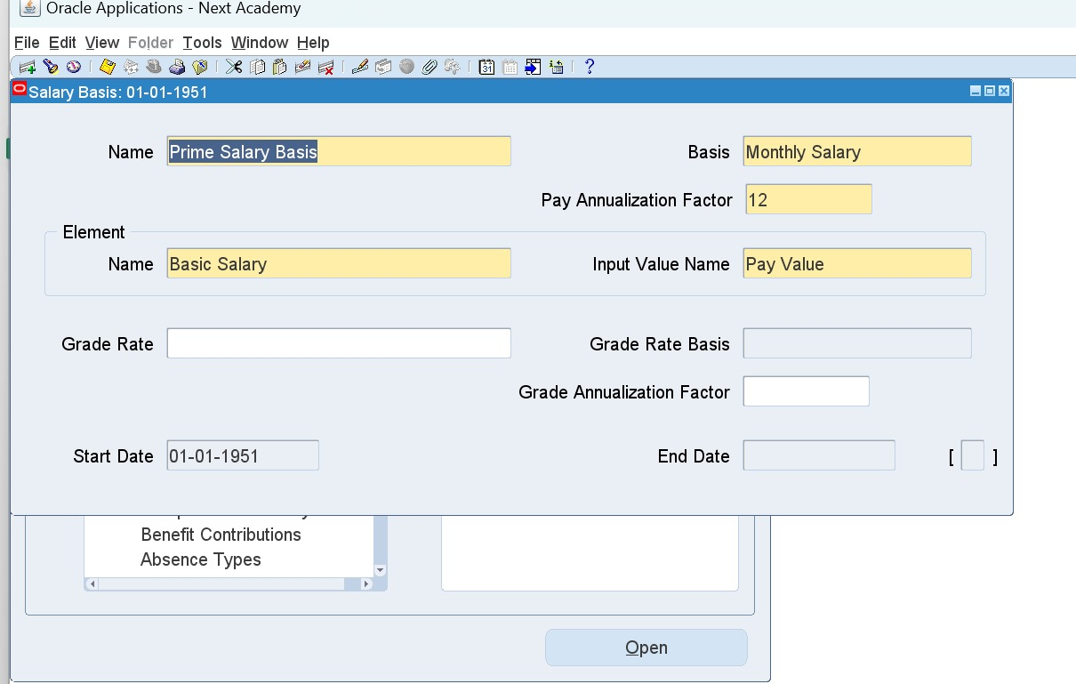
3. Define Salary Basis
HRMS > Total Compensation > Basic > Salary Basis
Add Salary Basis Name: Prime Salary Basis
Choose created element: "Basic Salary“
Input Value: Pay Value

Slide 45

Assign Salary to Employees

Slide 46
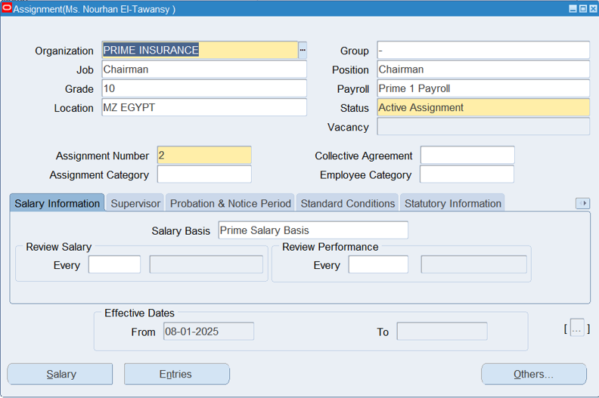
1. Choose Salary Basis
HRMS > People > Enter and Maintain > Assignment Window > Salary Information tab
Choose defined Salary Basis

Slide 47
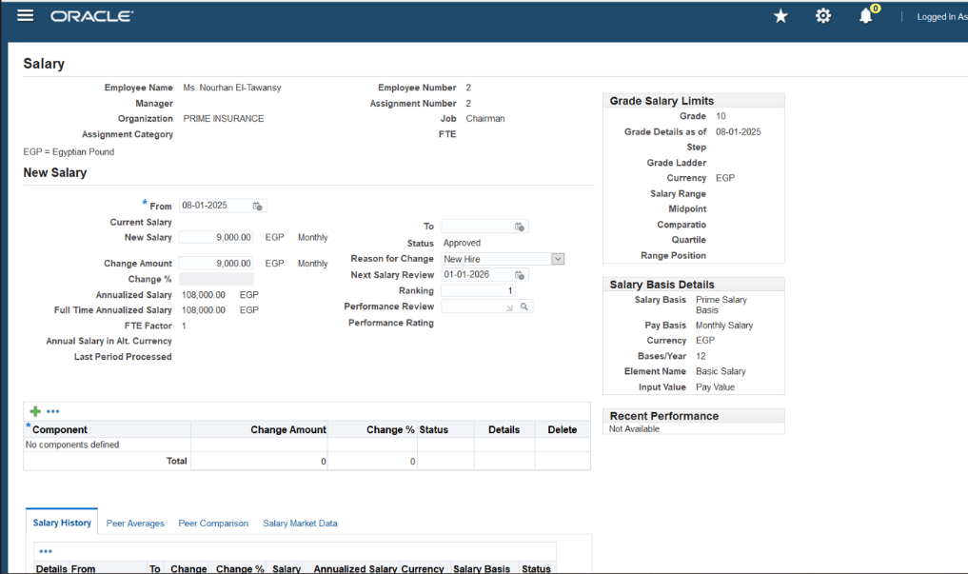
2. Add New Salary
HRMS > People > Enter and Maintain > Assignment Window > Salary Button
(Opens Salary Web Page)
From: Employment Effective Date
Add New Salary
Reason for Change - Lookups (Proposal Reason): New Hire
Next Salary Review Date

Slide 48
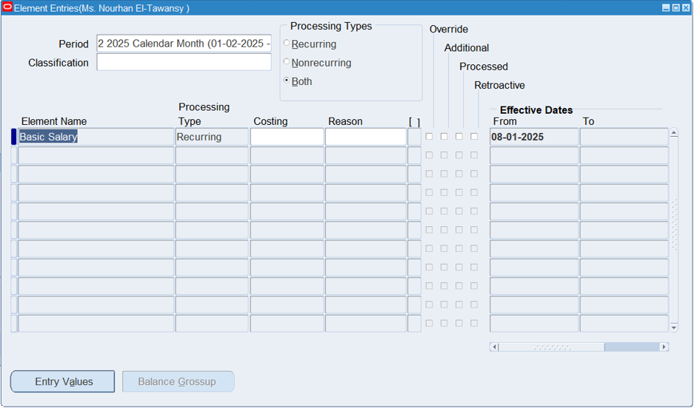
Press Apply - It reflects in Employee's Entries window (Assignment window)

Slide 49
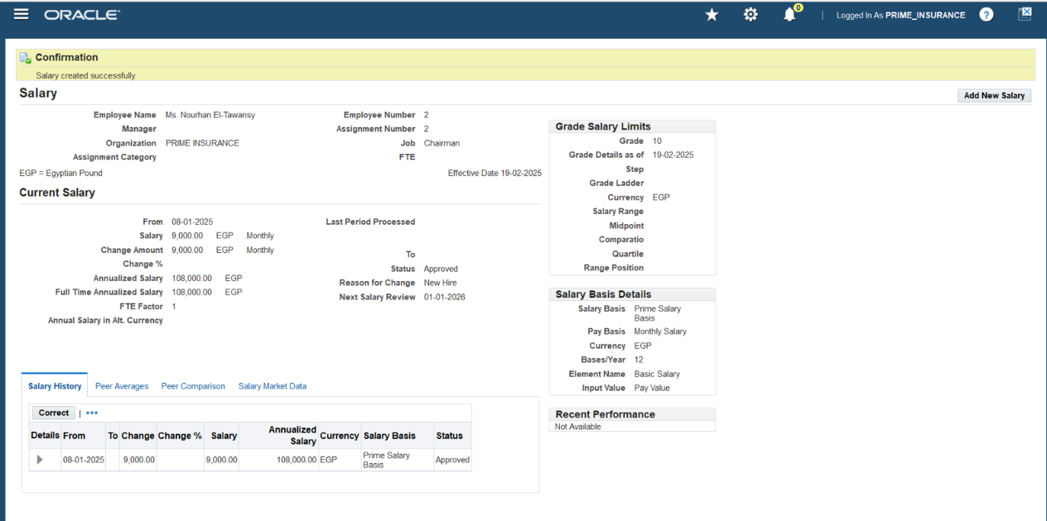
Now it is added to Salary History grid

Slide 50
Edit Assigned Salary
HRMS > People > Enter and Maintain > Assignment Window > Salary Button
Salary History
Correct button
Edit amount
Apply
Delete Assigned Salary
Salary History (Move to the right and press on delete icon)

Slide 51
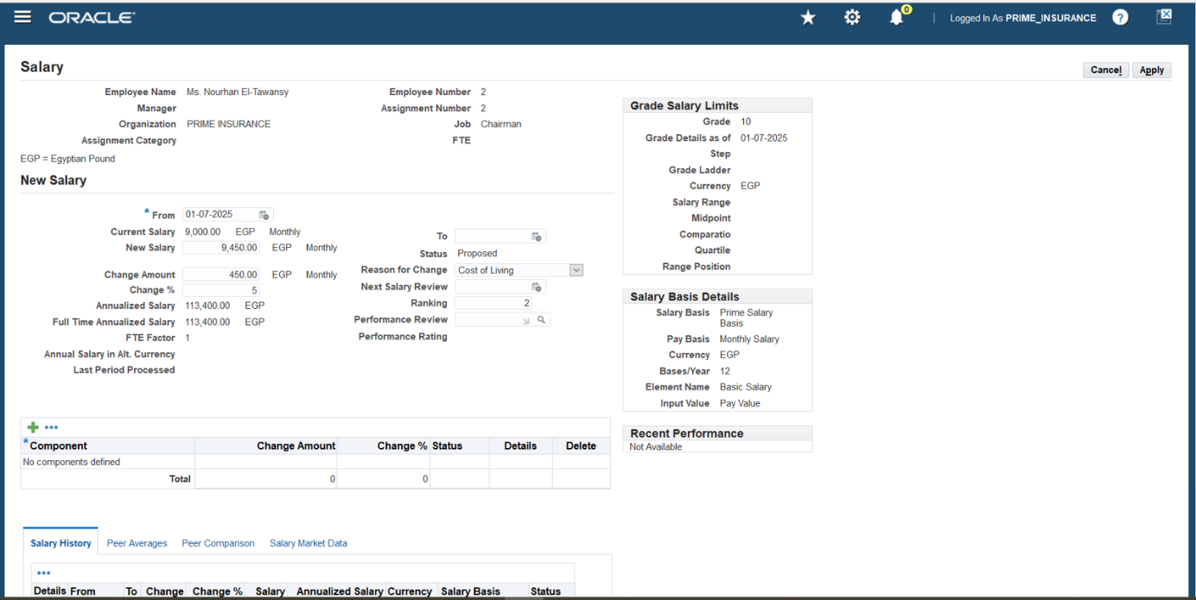
To Add a Salary Increase
HRMS > People > Enter and Maintain > Assignment Window > Salary Button
Add New Salary Button
Add the new date
Change % = Only the percentage and it will automatically get calculated
Reason for Change: COLA
Ranking:2

Slide 52
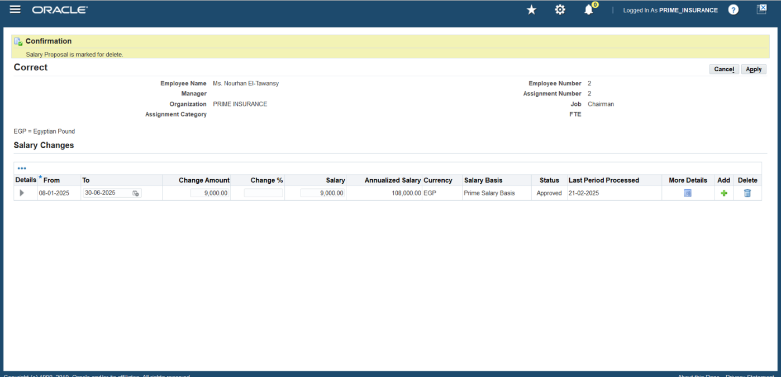
Remember to add an end date to the old salary
This new salary is proposed and should be approved

Slide 53
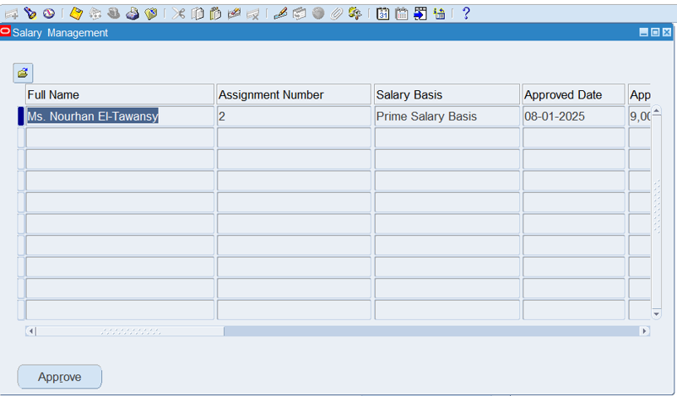
Approve Proposed Salary
HRMS > People > Salary Management
Ctrl + F11 to show proposed salaries
Review and press Approve

Slide 54
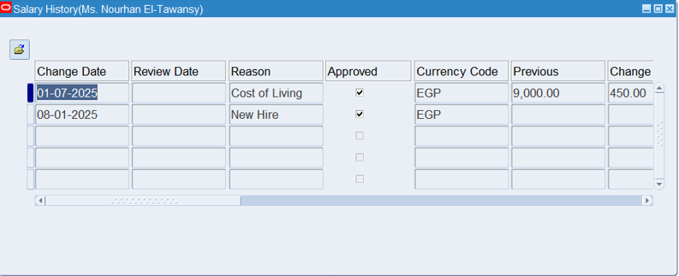
Salary History
HRMS > Fast Path > Salary History
Ctrl + F11 to show all salary changes

Slide 55
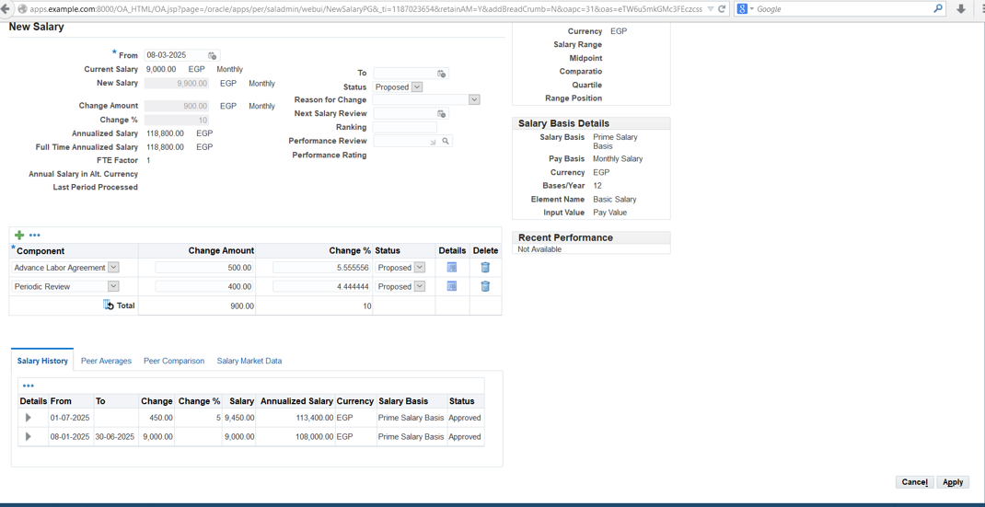
Salary Component
It is used when proposing more than one change on the same exact date.

Slide 56
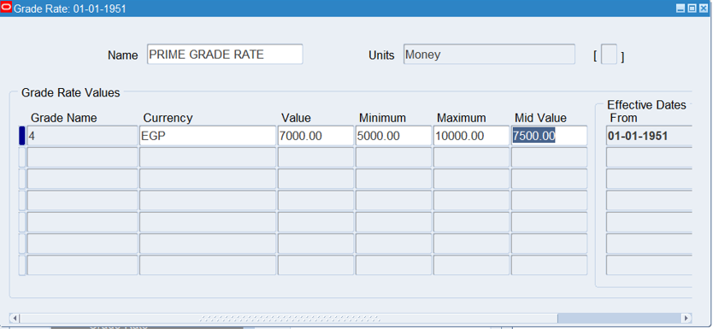
Grade Rate
HRMS > Work Structure > Grade > Grade Rate
While adding salary basis grade should be identified, and when adding salary for an employee holding this grade, it should fall within this range.
Note: Grade Rate should be defined before assigning salary basis to employees.

Slide 57
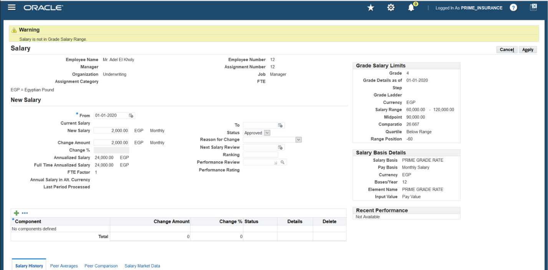
System automatically generates a warning to prevent salary not within the grade rate.

Slide 58

Quick Pay Run (ONE EMPLOYEE)

Slide 59
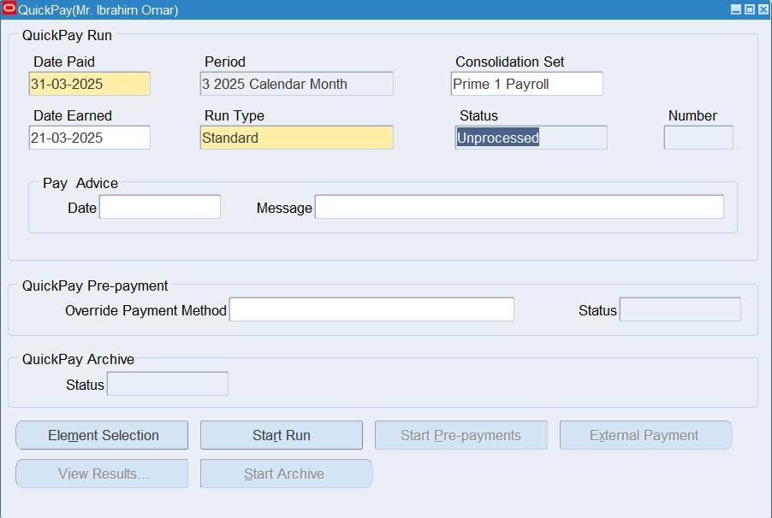
HRMS > People > Enter and Maintain > Assignment > Others > Quick Pay
Run Type: Standard
Date Paid: Last date of the current month 31/03/2025

Slide 60
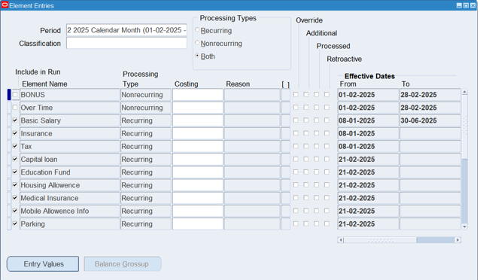
Element Selection Button opens Element Entries window to review included elements.
Start Run Button starts the quick pay run.

Slide 61
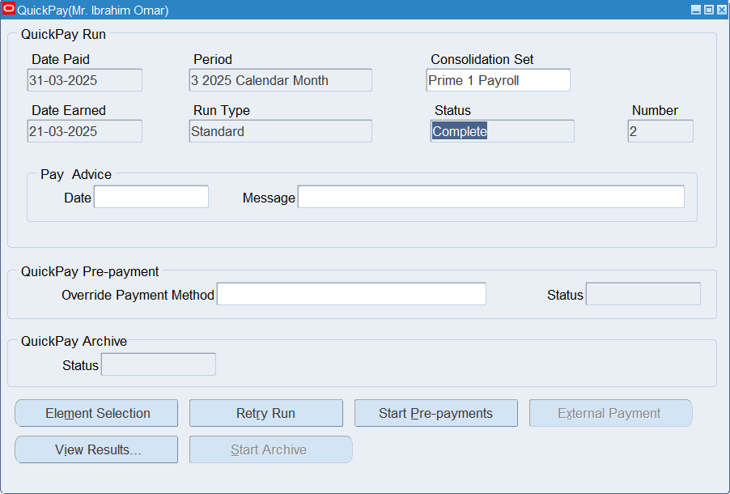
Once status is Complete, View Results Button gets activated to view the following:

Slide 62
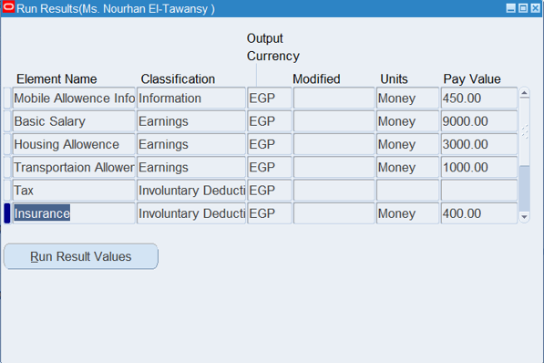
1. Run Results

Slide 63
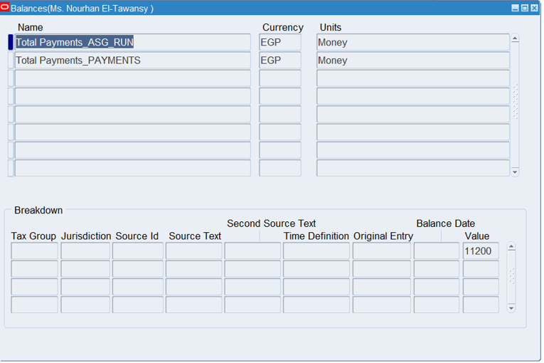
2. Balances
After running quick pay, Balances button shows all balances included.

Slide 64
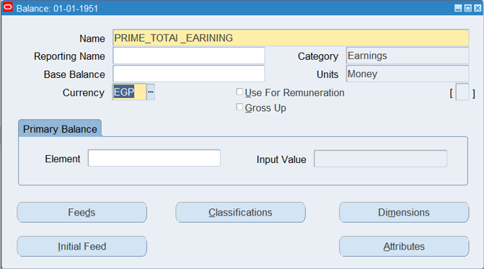
To create you own balance lists ex. Earnings -Voluntary and Involuntary Deductions - Net Salary
HRMS > Total Compensation > Basic > Balance

Slide 65
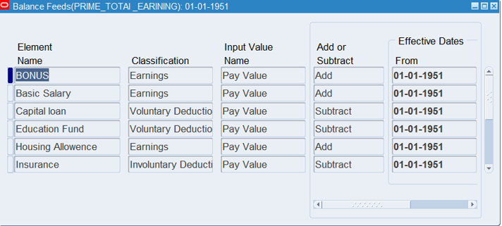
1. Feeds Button is to review and add each element separately

Slide 66
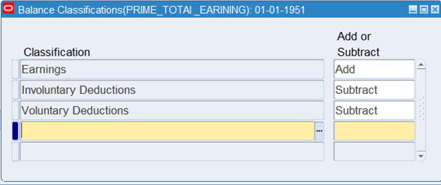
2. Classifications Button is to add whole set of a category at one time into feeds. Ex. Earnings, deductions, etc.

Slide 67

3. Dimensions Button should be added after creating the balance. (Name: Assignment Run)

Slide 68

Re-run quick pay after repeating the process to create balances lists and this is how it looks:

Slide 69


Global Value
HRMS > Total Compensation > Basic > Global Value
Format: Upper Case with no spaces
Create once and edit its value in a future date and it shall keep history saved non-changed

Slide 70

Batch Element Entry (BEE)

Slide 71


Assignment Set and Element Set

Slide 72


1. Assignment Set
HRMS > Payroll > Assignment Set
Add Name (no spaces)
Choose Current Payroll
Status: Active
Amendment Button: Add employees into the assignment set

Slide 73

2. Element Set
HRMS > Payroll > Element Set
Include Element: Adds element to the set
Exclude Element: Removes element from the set
Classification Rules: Adds all elements based on their classification (ex. Earnings)

Slide 74

Batch Element Entry (BEE)
HRMS > Mass Information eXchange MIX > Batch Element Entry
1. Alter Date to first day of the current month
2. Batch Name (should be saved somewhere safe)

Slide 75


Steps to enter “One Element” (different values) to “Many Employees”
1. Create a non-recurring element and element link
HRMS > Total Compensation > Basic > Element Description
HRMS > Total Compensation > Basic > Link

Slide 76

2. Create BEE
HRMS > Mass Information eXchange MIX > Batch Element Entry
Check Action:
A. Create New Entry:
Enter new element to entries (even if it already exists)
3. Press on Element Lines Button to add employees to which this element should be entered

Slide 77

Data Loader can help here
Add the different Pay Value for each employee in Pay Value column

Slide 78

4. Process Button > Choose Validate
(Messages Button to review any errors)

Slide 79

View requests to make sure running is complete

Slide 80


Status will be Error or Valid

Slide 81

5. After status is Valid,
Process Button > Transfer
Status will be Transferred - this means the element is already reflected in Entries window for each added employee

Slide 82

Check element entries for selected employees

Slide 83

B. Reject Entry:
Reject entry if already exists (for each employee separately)

Slide 84

C. Change Existing Entry:
Changes element value. Date Effective Changes should be specified

Slide 85

Rollback Request to cancel the BEE
HRMS > View > Requests
Name: BEE Rollback
Parameter: BEE Name
Status will return to Unprocessed, and element will be deleted from people's Entries window.

Slide 86
BEE Summary
HRMS > Mass Information eXchange MIX > BEE Summary
Ctrl + F11 to display data

Slide 87


Steps to enter “One Element” (different values) to “Many Employees”
1. Create Assignment Set:
HRMS > Payroll > Assignment Set
Amendment button to add employees

Slide 88


2. Create a non-recurring element and element link:
HRMS > Total Compensation > Basic > Element Description
HRMS > Total Compensation > Basic > Link

Slide 89

3. Create Batch Element Entry (BEE):
HRMS > Mass Information eXchange MIX > Batch Element Entry
Press on Assignment Set

Slide 90

Assignment Set window to choose:
Assignment Set
Payroll Name
Element Set or Element
Add Value in Pay Value field
4. Process Button > Choose Validate
(Messages Button to review any errors)
5. After status is Valid, Process Button > Transfer

Slide 91

Payroll Run

Slide 92

1. GL Flexfield Map
HRMS > Payroll > GL Flexfield Map
Ctrl +F11 to find my payroll
Ledger (Financial)
A. Payroll Costing Segment:
(Segments of Cost Allocation Flexfield)
B. GL Chart of Accounts Segment
(Segments of Accounting Flexfield)

Slide 93

2. Costing
Create an element and element link:
HRMS > Total Compensation > Basic > Element Description
HRMS > Total Compensation > Basic > Link
While linking the element, check Costed and fill out Costing and Balancing flexfields
Both should be the same

Slide 94


3. Pre-payment (Quick Pay)
To be run for one employee
HRMS > People > Enter and Maintain > Assignment > Others > Quick Pay
Run Type: Standard
Date Paid: Last date of the current month 31/01/2025
Start Run Button
Then
Start Pre-payments Button
Helps distribute earnings according to payment percentages setup

Slide 95


Press on View Results
Payment Methods option shows up to show the amounts distribution in case of choosing more than one payment method for the same salary.

Slide 96

Here, we decided 100% of the salary will be paid in cash so that is the only entry we have here.

Slide 97

Rollback to cancel the quick pay pre-payment
HRMS > View > Requests
Name: Rollback - Parameter: QuickPay Pre-payments

Slide 98


Payroll Run
1. Create an Assignment Set
HRMS > Payroll > Assignment Set
Name (no spaces) - Payroll – Active
Amendment Button: Add employees into the assignment set

Slide 99

2. Run Payroll Request
HRMS > View > Requests
Fill out the parameters:
Payroll Name
Consolidation Set
Pay Period
Assignment Set

Slide 100

Now elements are all processed

Slide 101

Payroll Process Results
To review payroll run results
HRMS > View > Lists > Payroll Process Results
Press on Assignment Process Button to view employees

Slide 102


Slide 103

Employee Assignment Process Result
HRMS > View > Lists > Assignment Process Results
To review an employee's history

Slide 104

View Results Button shows the detailed display of elements

Slide 105

Payroll Rollback Run
HRMS > View > Requests

Slide 106

Payroll Process Results
To review payroll run results
HRMS > View > Lists > Payroll Process Results

